Slide 1
Study Room: E-learning QA Module
Prepared By :-
Abhinav Paudel(15449)
Mandeep Panta(15464)
Ashbin Thapa(15455)

Slide 2
Table of Content
Introduction
Problem Statement
Project Objective
Feasibility Study
Scopes And Limitations
Methodology
Working Schedule

Slide 3
Introduction
Study Room is a question and answers website for programmers. This web application will act as the platform where developers can ask and answer technical questions related to programming, software development, and other technology-related topics.

Slide 4
Problem definition
Lack of easy to understand coding community for asking coding problem’s solutions.
Struggle to get authentic answer for the questions and determining the correct answers.

Slide 5
Objectives
The Website aims to:
To develop web application for asking and answering the questions related to various faculties.
To allow people to communicate to increase flow of information among them.
To Create an interactive and user friendly web-application which also helps in building a learning community

Slide 6
Feasibility study
A system development project may be regarded as economically feasible or good value to the organization if its anticipated benefits outweigh its estimated costs.
There are 3 types of feasibility study:
1. Operational Feasibility
2. Economical Feasibility
3. Technical Feasibility

Slide 7
Operational Feasibility:
A systems development project is likely to be optionally feasible if it meets the ‘needs’ and expectations of the organization. It is mainly related to human organizations and political aspects.. The points which are considered are :
i) What changes will be brought with the web application : Study Room?
ii) What skills will be required to operate the website?
iii)Does the Knowledge to operate the website exist within the targeted Group? If not, can they be learned in due course of time?
It fulfills all the aspect of operational feasibility study as all the member of the project is well skilled, and there are no organizational and political constraints.

Slide 8
2. Economic Feasibility:
Economic justification is generally the “Bottom Line” consideration for most systems. Economic justification includes a broad range of concerns that includes cost benefit analysis. In this we weight the cost and the benefits associated with the system. The purpose of the economic feasibility assessment is to determine the positive economic benefits to the organization that the proposed system will provide. It includes quantification and identification of all the benefits expected . The financial and the economic questions during the preliminary investigation are verified to estimate the following :
i)The cost to conduct a full website Operation of Study Room.
ii)The cost of hardware and software required for the Website to operate being considered .
iii)The benefits in the form of reduced cost . This feasibility checks whether the website can be developed with the available funds. The Study Room System does not require large amount of money to be developed. This can be done economically and executed in a planned manner, so it is economically feasible.

Slide 9
Technical Feasibility:
This is concerned with specifying equipment and software that will successfully satisfy the user requirement. This evaluation determines whether the technology needed for the proposed system is available or not.
Technical Feasibility Study can answered the following question :
Can the work of Study Room be done with existing equipment?
Can Study Room be upgraded if required ?
iii) Can a solution be supported with existing technology?

Slide 10
Scopes and limitations
SCOPES
The targeted people are programmers and developers.
This web application can be modified and used for various college/school or even universities.
LIMITATIONS
Study Room is a website and not an app.
This web application is mainly focused towards developers.

Slide 11
Methodology
We have planned to work following these methodologies for the application of knowledge, skills and technique to broad range of activities in order to meet the requirement of our project.
To complete this project, the following methodology / process has been conquered.
SOFTWARE DEVELOPMENT LIFE CYCLE
The framework we will be using for developing this project is Iterative model. Iterative model is simple and emphasizes on initial and simple implementation and with progress in the project it gains more feature. It is advantageous since it has unique feature of repetitive nature. The phases of the linear sequential model are: Analysis, Design, Testing and Implementation.

Slide 12
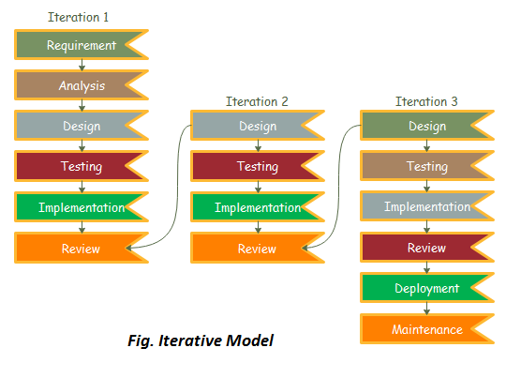
Iterative model

Slide 13
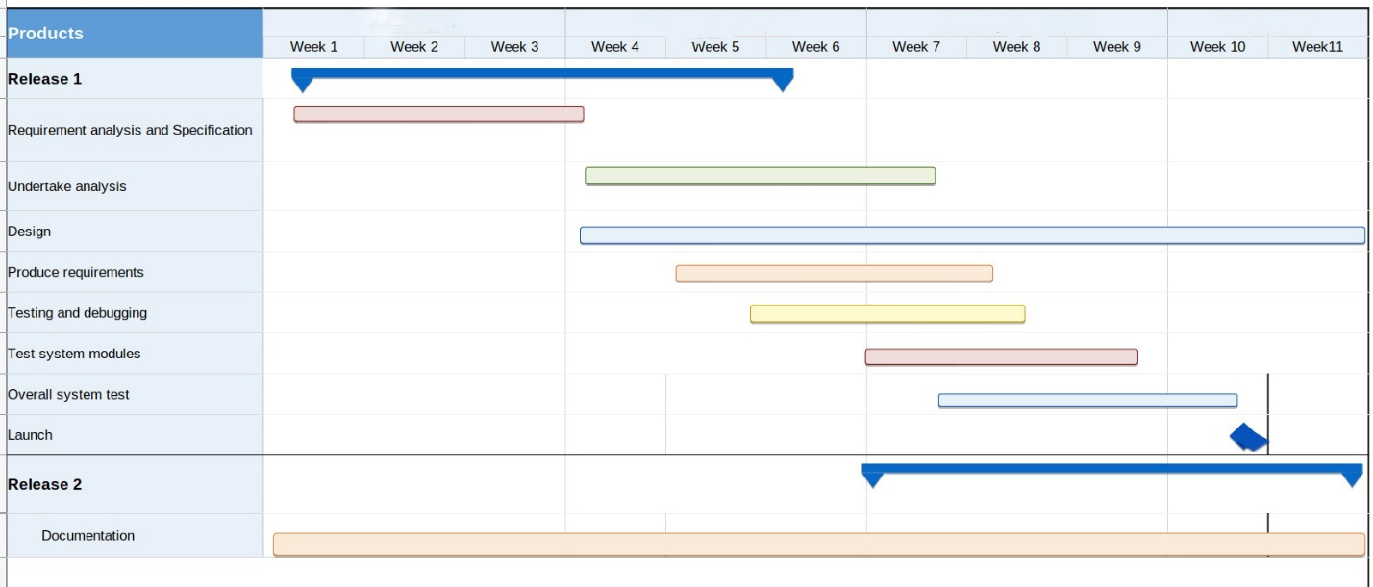
Working Schedule

Slide 14
References
Reger S. Pressman, Ph.D. Seventh Edition, Software Engineering: A Practitioner’s Approach, McGraw Hill, 2010
Beginner Python Tutorial Available at: http://www.homeandlearn.co.uk/python/php.html(11.18.2018)
The Python Language Reference Manual (version 2.5) by Guido van Rossum, and Fred L. Drake, Jr. (Editor)
Python in a Nutshell by Alex Martelli.

Slide 15
THANK YOU

